Slide 1
Robot Construction, Wiring, and Safety
SSI Robotics
September 7, 2013
Capitol College
Notes:
Add topic slide: include that it concentrates on manual operation (i.e. tile-op)

Slide 2
Agenda
Basic construction
Build it strong
Build it stable
Build it to last
Protect sensitive parts
Gearing
Make motors do more
Safety
Servos
Safety
Wiring
Make it reliable
Samantha
Minimize ESD issues
Notes:
Will this help students transition to C.

Slide 3
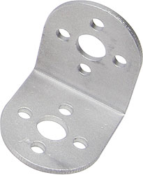
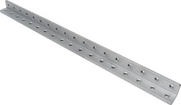
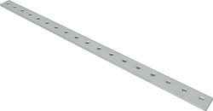
Basic Construction
Build it strong
Right angles are weak
Triangles are strong
Reinforce where necessary with angled supports
Angles beams are stronger than flat beams
Notes:
Will this help students transition to C.

Slide 4
Basic Construction
Build it stable
Keep the center of gravity low to keep the robot stable
Notes:
Will this help students transition to C.

Slide 5
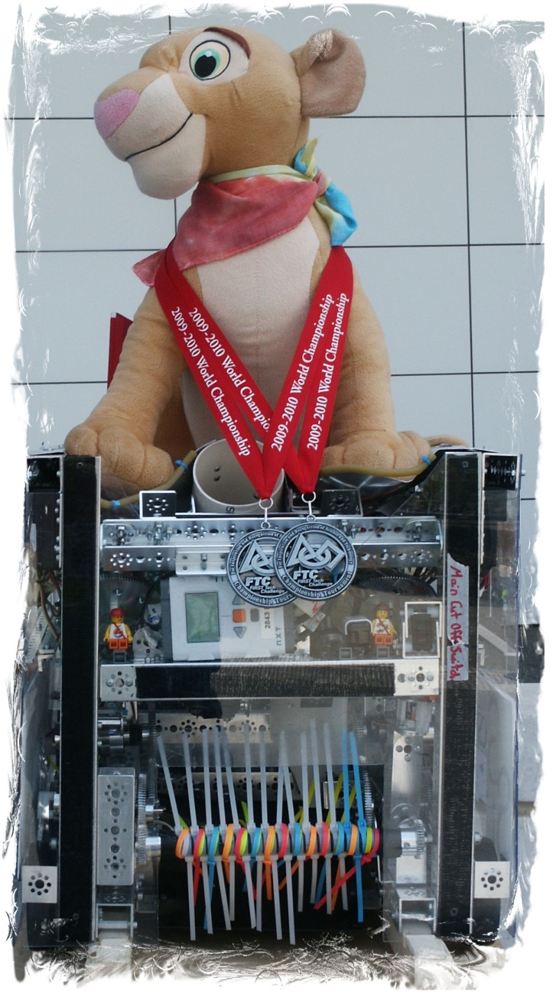
Basic Construction
Build it to last
Ran entire World Championship with NO major repairs required
7 qualifiers
4 eliminations
Notes:
Will this help students transition to C.

Slide 6
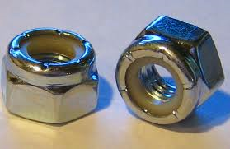
Basic Construction
Build it to last
Tetrix kit comes with “kep” nuts
These are ok but will loosen over time
I recommend nylon lock nuts
Much less likely to loosen up
Note, they will wear out if removed and reinstalled many times
Loctite is also useful to keep nuts where they belong
Don’t use only the minimum number of screws
One screw might hold, but 4 will hold it better
Notes:
Will this help students transition to C.

Slide 7
Basic Construction
Hint for axle collars
Use a standard screw instead of the included set screw
It will be easier to get a firm grip on the axle
Notes:
Will this help students transition to C.

Slide 8
Basic Construction
Protect sensitive parts
Use plastic sheeting to protect electronics
Mounting NXT, motor and servo controllers to plastic sheeting can help minimize effects of electrical noise
Electronics make poor bumpers
Mount the battery safely
No sharp edges to cut into the battery
A battery that shorts to the frame can cause major trouble
Mount power switch so it is easy for the FTA to reach, but hard for another robot to bump
Notes:
Will this help students transition to C.

Slide 9
Basic Construction
Protect sensitive parts
Make numbers out of a material that will withstand game play
Laminated paper works well
Laminated paper behind a plastic sheet works really well
You don’t want them to tear off during a match
Remember the 3” size is the Minimum (not maximum)
Notes:
Will this help students transition to C.

Slide 10
Gearing
Use gearing to make your robot work better
Use gears between the motor and drive wheels
Mounting the wheels directly to the motors makes it hard to get all wheels at the same level
Gearing the wheels to the motor allows the wheel axles to be in a frame member which should make it easier to get all the wheels at the same level
Make your motors do more
Gears are a force multiplier to allow a motor to do more work
Make sure the gears mesh properly and all axels are properly supported
Chain and sprocket systems can work the same as gears over a longer distance
Notes:
Will this help students transition to C.

Slide 11
Gearing
Gear safety
Provide shielding if possible to prevent fingers or wires from getting caught in the gears.
Using gearing to drive a mechanism too fast can be dangerous
Treads can spin off of tires….
Using surgical tubing along with gearing can make a motor’s job easier
To help lift an arm
To help pull in the legs of a scissors lift
Notes:
Will this help students transition to C.

Slide 12
Servos
Servo safety
If you have servos that move during robot initialization, you MUST put a safety label by the power switch to indicate this. This is stated in the game manual <RG04> b
Make sure the servo is mounted securely
The old servo brackets were not very strong
I have not seen the new options, they may be better
We have made custom brackets out of 1” square aluminum tube
Notes:
Will this help students transition to C.

Slide 13
Wiring
Make it reliable
The terminal blocks on the motor controllers are not very reliable for passing power to other controllers
Use some type of terminal strip for more reliable power connections
An example of using Anderson Powerpoles is available in the FTC document library (off of Team Resources)
We have used a variation of this using an Anderson Powerpole splitter allowing us to have redundant connections to each controller
Notes:
Will this help students transition to C.

Slide 14
Wiring
Make it reliable
Check wiring before and after EVERY match
Last year at the World Competition, a robot was showing a low battery error on the Samantha during a couple of its matches (flashing red light)
The battery was not low
The problem was tracked down to a loose power connection to the Samantha
Do not route wires where they will be damaged by robot mechanisms
Be careful of rotating mechanisms that have motors on them
Be careful of running wires too close to gears
Be careful of pinch points
Notes:
Will this help students transition to C.

Slide 15
Wiring
Make it reliable
Tie down all wiring
If it is tied down, it can’t move into a pinch point
It will be harder for another robot to get tangled up in your wiring
Tie the motor power wires to the motor to keep them from coming loose
Keep it neat
This makes it easier to track down problems
It will probably also impress the judges
Notes:
Will this help students transition to C.

Slide 16
Wiring
Make it reliable
Don’t run power wires beside signal wires
Motor or servo wires routed beside the I2C wires can induce noise on the I2C bus
This can cause data errors
Keep the USB cable from the Samantha separate from all other wires
Use the shortest possible cable
This should help prevent data errors on the USB bus
Notes:
Will this help students transition to C.

Slide 17
Samantha
Minimize ESD issues
Mount the Samantha high and not surrounded by metal to allow a clean Wi-Fi signal
Make sure all wire connections are tight and cannot move during match play
Use a high quality shielded USB cable with ferrite chokes
Add ferrite chokes, if needed to other wiring on the robot
Notes:
Will this help students transition to C.

