Slide 1
RobotC Advanced Concepts
SSI Robotics
September 7, 2013
Capitol College
Notes:
Add topic slide: include that it concentrates on manual operation (i.e. tile-op)

Slide 2
Topics
Variables Types
bool, byte, char, float, long, int, short, string, word, ubyte, void
Conditional Statements
do-while, for, if-else, switch, while
#ifdef #else #endif
Initialization
Header files
Functions
Accidental program abortion
Automatic brick power down
Autonomous Input
NXT Buttons
Tasks
Waiting
Motor Functions
bFloatDuringInactiveMotorPWM
bMotorReflected
Notes:
Will this help students transition to C.

Slide 3
Variable Types
bool - 0=false, everything else is true
byte - [-128,127] - 8 bits
char - same as byte, but the value represents a character
float - 32 bits
long - [-2147483648,2147483647] - 32 bits
int - [-32768, 32767] - 16 bits
short - same as int
string - array of characters - null terminated
word - same as int
ubyte - [0,255] - 8 bits
void

Slide 4
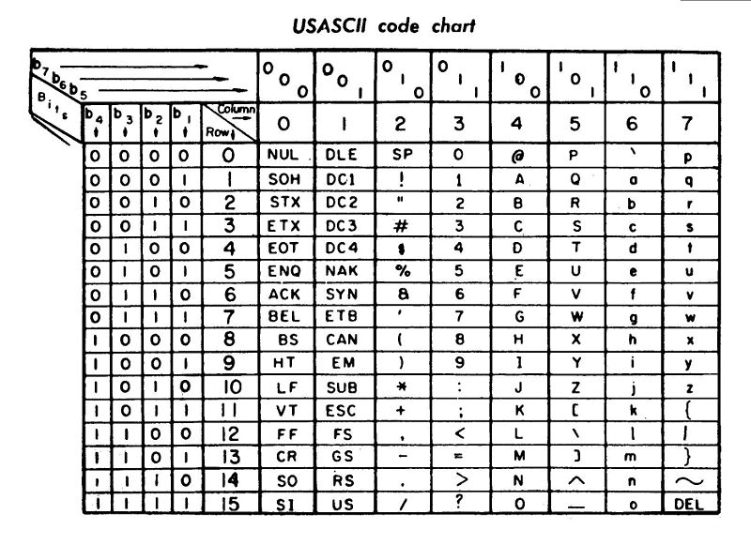
ASCII Table
42 = ‘B’
http://en.wikipedia.org/wiki/File:ASCII_Code_Chart-Quick_ref_card.jpg

Slide 5
Conditional Statements
if-else - determines which action is performed based on a test (NXT button example)
switch - determines which action is performed based on a value (autonomous activation example)
do-while - performs an action one or more times (NXT button example)
while - performs an action zero or more times based on a test (infinite manual loop example)
for - performs an action zero or more times based on an incremental value (accelerometer initialization example)

Slide 6
Source Code Structure
JoystickDriver.c
Installs with Robot C
File | New | New File
- OR –
Window Explorer | Right Click | New | Text Document
common.h
accelerometer.h
Autonomous.c
Manual.c
File | New | Autonomous Template
File | New | User Control Template
Notes:
JoystickDriver.c is included into both Autonomous.c and Manual.c.
Common.h is included into both Autonomous.c and Manual.c.
Accelerometer.h is included into only common.h, but is indirectly included into both Autonomous.c and Manual.c.

Slide 7
Autonomous vs. Manual
Initialization
Functions
Algorithm Selection
Tasks
Wait For Start
Infinite Loop
Process Sensor Input
Drive Motors
Etc.
Initialization
Functions
Algorithm Selection
Tasks
Wait For Start
Infinite Loop
Process Joystick & Sensor Input
Drive Motors
Etc.

Slide 8
Initialization
Brick
nNxtExitClicks
nPowerDownDelayMinutes
disableDiagnosticsDisplay (i.e. bDisplayDiagnostics)
Sensors
Reset motor encoders
Motors
bFloatDuringInactiveMotorPWM
bMotorReflected (discussion only, no example)
Servos
servo and servoTarget are equivalent functions.

Slide 9
initializeRobot
InitializeRobot is a function provided in the RobotC template (File | New | Autonomous Template or File | New | User Control Template).
It is an example of an in-file function.
It has no return value; it accepts no parameters.
It is called by task main.
initializeRobot has been renamed ‘initialize_autonomous’ in the autonomous template and ‘initialize_manual’ in the manual template for the sake of this presentation.
By default, it does nothing. Useful, huh? Well after you add some code to it, it will be.

Slide 10
bDisplayDiagnostics
This resides in JoystickDriver.h.
It is set to true by default, so diagnostics (external battery level, NXT battery level, FMS message count, and file name) will be displayed on the NXT screen.
Set it to false or call disableDiagnostics if you want to exclusively use the screen.
For this presentation, it has been set to false in the initialization function.

Slide 11
nNxtExitClicks
nNxtExitClicks is an intrinsic word defined in RobotCIntrinsics.c. If you want more information on intrinsic words, see http://robotc.net/forums/viewtopic.php?f=1&t=5915
It is used to prevent accidental program abortion.
Syntax: nNxtExitClicks = 3;
The dark grey button will need to be pushed 3 times in rapid succession to exit the currently running application.
Replace ‘3’ with some other number [-32768, 32767] to change its behavior. Note, if you choose a very large number (-1 for example), then you might as well pull the battery, stop the program with Robot C, etc…
This statement can be placed in initialize_autonomous and initialize_manual, but there is a better way.
Notes:
Setting it to zero or one causes the same behavior – hit the button once and the application stops.

Slide 12
nPowerDownDelayMinutes
Set this to zero to prevent the brick from sleeping during the match. This tells the brick to never fall asleep.
The inspection process includes a step that sets the brick’s sleep timer to never.
If bricks are swapped, please visit inspection again, but also make sure that the sleep timer is set to never before a match.
Similar NXT Battery and Power Controls
These aren’t used, but might be fun reading
alive, powerOff, bNoPowerDownOnACAdapter, bNxtRechargable, LowVoltageBatteryCountLimits, nAvgBatteryLevel, nImmediateBatteryLevel, externalBattery

Slide 13
bFloatDuringInactiveMotorPWM
When set to true, the motors will float or coast when power is not applied.
When set to false, the motors will brake when power is not applied.
This is useful when you have spinning motors at the end of the match. When set to true, the motors will slow to a stop, which prevent gear boxes from cracking.
Careful, it is applied to ALL motors!

Slide 14
bMotorReflected
This intrinsic word can be used instead of using the Motors and Sensor Setup menu.
Syntax: bMotorReflected[name_of_motor] = true
Set it to true and the applied power level will be automatically negated.
Set it to false and the direction indicated by the sign of the power (positive drives the motor in one direction; negative, the other) is not modified.

Slide 15
Functions
Functions can reside in the same file as task main or reside in some other file, usually with a .h extension (‘h’ stands for header). Though RobotC often includes ‘.c’ files into other ‘.c’ files.
Suppose you want the exit click functionality to apply to both the autonomous main and manual main tasks.
Perform the following
Create a file called common_initialization.h.
Add the common_initialization function.
Move the ‘nNxtExitClicks’ statement from initialize_autonomous and initialize_manual to the new common_initialization function.
Include the common_initialization header file into the autonomous and manual ‘.c’ files.
Call common_initialization from task main (both autonomous and manual).
Note that the return statement is optional.
Now, that’s slick. External header files can also be used to manage multiple autonomous routines.

Slide 16
Algorithm Selection
Suppose you have multiple autonomous routines, but you don’t want to use RobotC or the program chooser at the beginning of every match.
Instead of writing the autonomous routines as separate ‘task main’s, write them using functions and call them from a single task main (in the autonomous template).
The functions can all be in the same file as task main, all in a separate file (ex. auto_routines.h), or each in its own file (ex. auto_1.h, auto_2.h, etc.). If they are in separate files, remember to include the function’s file(s) into the autonomous .c file.
The buttons on the brick can be used to select which autonomous function that ‘task main’ calls.
Notes:
Auto_routines.h is not provided with this presentation.
The autonomous routines are in auto_1.h, auto_2.h, and auto_3.h for presentation purposes.

Slide 17
NXT Buttons
nNxtButtonPressed indicates which button, if any, is being pressed.
A value of 3 indicates that the large orange button is being pressed; 2 is the light grey button to the left of the orange button; 3, the light grey button to the right of the orange button; 0, the dark grey button below the orange button; -1, no button is being pressed.
Note that the button code is in a do-while loop. That loop executes so quickly, that multiple button presses would register. The toggle variable prevents this.
Notes:
Note that nNxtButtonPressed will never be zero unless nNxtExitClicks is some value other than zero and one.

Slide 18
Sensors (An Accelerometer Example)
Suppose you want to maintain a list of the last 16 readings from an accelerometer. This can be incorporated into the main task, but…
It will be harder to maintain this code as the size of your program grows larger.
The same code might be needed in autonomous and manual operation.
The initialize_the_accelerometer function resides in accelerometer.h.
It requires a driver supplied in the RobotC example ‘drivers’ folder called hitechnic-accelerometer.h. You can copy and paste that file into your source directory or modify the include statement to indicate the location of the driver’s header file.
#include “Sample Programs/NXT/3rd Party Sensor Drivers/drivers/hitechnic-accelerometer.h”

Slide 19
Sensor Pragmas
The motor and sensors dialog can be used to configure the accelerometer to a sensor port.
Do NOT use HiTechnic Sensors | HiTechnic Accel.
The pragmas at the top of autonomous.c (and manual.c) need to have a line for the sensor.
Note the third parameter “Accelerometer”. It is the name assigned to the sensor on sensor port 1.
The initialize_the_accelerometer and update_sensors functions require the third parameter.
It is case sensitive.
It is important that changes made to the pragmas in one template are applied appropriately to the other template.
An exception are pragmas that aren’t used by the other template, but in GENERAL, the auto and manual should be the same.
Notes:
Note: Don’t use the HiTechnic Sensors | HiTechnic IRSeeker 600 or 1200.

Slide 20
Tasks
Tasking allows code to be placed into a “function” that runs “concurrently” with the main task.
Ten tasks at most can be executed concurrently within an NXT user program.
The StartTask intrinsic function takes one parameter, the name of the task.
The t_update_sensors task calculates the average accelerometer values over the past 16 iterations.
It can be started before the waitForStart call.
Tasks can be started there as long as robot movement doesn’t result. Robots must stay within the 18 inch cube until started and they must not move parts until AFTER waitForStart is called.

Slide 21
waitForStart
Both the autonomous and manual templates call waitForStart. This macro executes until the FCS sends the begin-the-match signal.
Both templates then use an infinite loop to execute code to make the robot do something.
What can be done in that loop? Let’s see!

Slide 22
The Infinite Loop
This is where input is processed. Input can come from sensors on the robot or commands from the joystick controllers.
This is where you will place autonomous and manual code. If you have written your autonomous routine as a task, this loop is still required, so the task will not be killed when task main returns.
For example, the autonomous functions display the values of the global variables maintained by t_update_accelerometer.
To allow other tasks a chance to execute, a wait can be inserted that causes the main task to “sleep”.
“wait10Msec(X);” - replace ‘X’ with the amount of sleep time in the statement.
abortTimeslice (); // Allows other waiting threads to execute.
Let’s look at some manual code.

Slide 23
Processing Joystick Controller Joysticks
To obtain joystick controller input, use the intrinsic function getJoystickSettings.
There are four joysticks available at a competition: two on controller 1 (x and y) and two on controller 2 (x and y).
The y-axis is away and toward the human operator and has the range [+127,-128]. Negative is toward the human, positive is away from the human.
A joystick very RARELY equals zero when it is being neither pushed nor pulled.
Using the highest 99 positive values and lowest 99 negative values of the joystick to drive a DC motor provides a dead-zone (i.e. a power of zero is applied to the motor).
[109,127] drives the motor in the “positive” direction at a power level of [1,100].
[-109,-127] drives the motor in the “negative” direction at a power level of [1,100].
This is a very simple algorithm for mapping joystick positions to motor power. There are others to drive the robot at a slow speed and high speed, exponential speeds, etc.
The x-axis is left and right and has the range [-128, 127]. Negative is left, positive is right.

Slide 24
Processing Joystick Controller Buttons
To obtain joystick controller button values, use the intrinsic function getJoystickSettings (only a single call is necessary to obtain the joystick and button values).
The joy1Btn and joy2Btn functions return a boolean, which indicates whether a button is being pressed. The controller buttons are numbered 1-10. Supply these as parameters.
The presentation code uses joy1Btn (5) != false). If the button is being pressed then the first block of code will be executed. If false, then the second block. Many compilers (i.e. processors) can test “!=“ faster than “==“. Keep in mind that the conditional will need to test for the opposite condition.

Slide 25
Processing Sensor Data
Many times, sensors can be processed directly in the infinite loop.
Run a motor until a touch sensor has been triggered.
Turn a light on when the magnetic sensor detects a magnet.
Sometimes, it is better to place the code in a task as in the accelerometer example.

Slide 26
References
RobotC.net
Webpages
www.robotc.net
Forums
http://www.robotc.net/forums/index.php
SSI Robotics
Webpages
www.ssirobotics.the-spanglers.net/Programming
E-Mail
ftcquestions@ssirobotics.the-spanglers.net

