Slide 1
RobotC Basics
FTC Team 2843
SSI Robotics
October 6, 2012
Capitol College FTC Workshop

Slide 2
Agenda
The Brick
Sample Setup
Template
Multi Click Program Cancel
Configuration (Pragmas)
Joystick Data (get data)
Motor Control
Servo Control
Conditional Statements

Slide 3
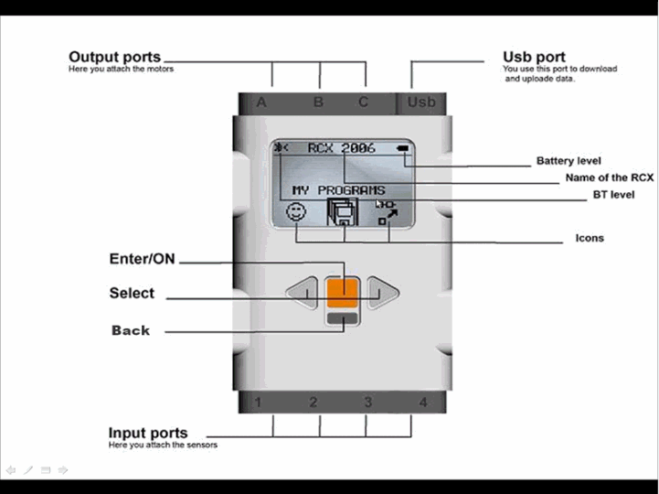
The Brick

Slide 4
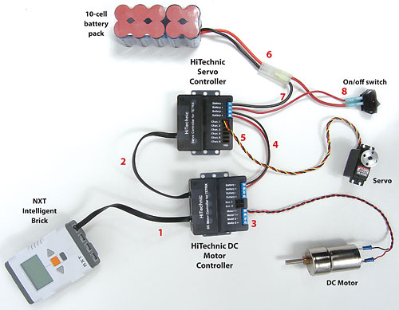
Sample Setup

Slide 5
Template

Slide 6
Teleop
//Pragmas Here
#include "JoystickDriver.c"
task main()
{
nNxtExitClicks = 3; //This is very important code
waitForStart();
while(true)
{
//Manual Control
wait10Msec(5); //Add in some delay
}
}

Slide 7
Configuration Wizard

Slide 8
Motor/Servo Controller

Slide 9
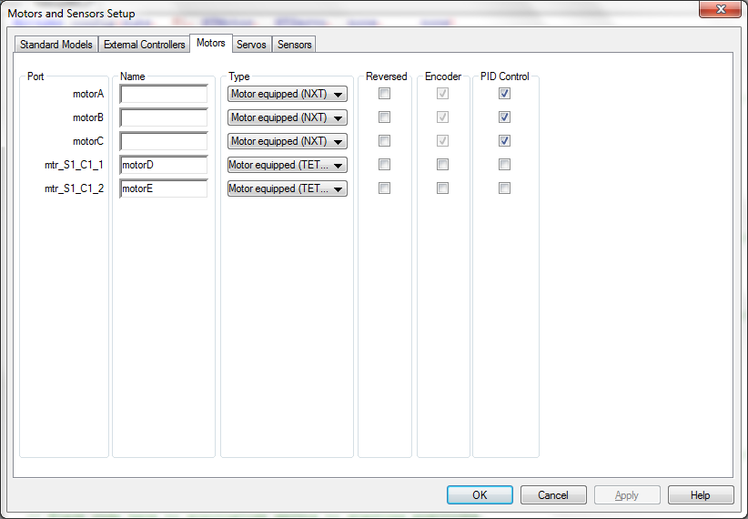
Motor Configuration

Slide 10
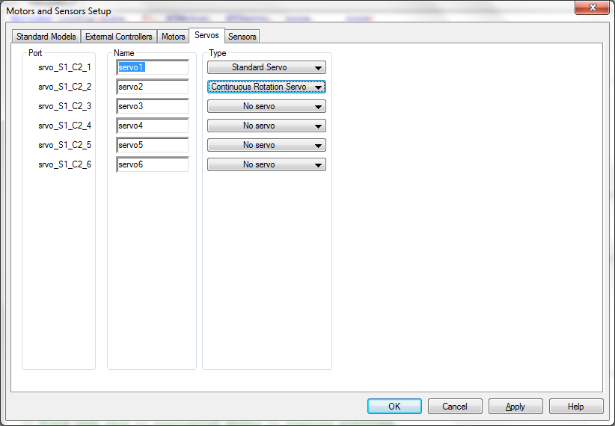
Servo Configuration

Slide 11
Sensors

Slide 12
Pragmas
Configuration Wizard
Motors
Servos
Sensors
Sensor Multiplexor

Slide 13
Reading Pragmas
#pragma config(Hubs, S1, HTMotor, HTServo, none, none)
#pragma config(Sensor, S3, HTSmux, sensorLowSpeed)
#pragma config(Motor, motorA, Didler, tmotorNormal, openLoop, encoder)
#pragma config(Motor, mtr_S1_C1_1, Left_Tread, tmotorNormal, PIDControl, reversed, encoder)
#pragma config(Servo, srvo_S1_C2_2, Lid, tServoNormal)
//*!!Code automatically generated by 'ROBOTC' configuration wizard !!*//

Slide 14
Joysticks
joy1btn(X), joy2btn(X)
Boolean
joystick.joy2_y1
+/- 100
joystick.joy2_TopHat
0 to 8

Slide 15
Conditional Statements
if(A==B)
{
//Code Here
}
else
{
//Code here
}
while(A==B)
{
//Code Here
}

Slide 16
Comparison Statements
A!=B A Not Equal to B
A==B A EqualsB
A<B A less than B
A<=B A less than OR equal to B
A>B A greater than B
A>=B A greater than OR equal to B

Slide 17
Motors
Assigning power:
motor[RightDriveWheels] = X;
motor[RightDriveWheels] = 0;
motor[RightDriveWheels] = -X;
Deadzone:
if((joystick.joy1_y1*joystick.joy1_y1)>25)
{
Left_Tread_speed=joystick.joy1_y1;
}
PID: Sometimes a problem

Slide 18
Servos
Continuous
servo[Bucket]=X;
Range: -127/+127
180 degree
Same as Continuous but assigns position
Range: 0 to 255

Slide 19
References
RobotC.net
http://www.robotc.net/NaturalLanguage/
SSI Robotics
www.ssirobotics.the-spanglers.net/Programming
ftcquestions@ssirobotics.the-spanglers.net

Slide 20
Intermediate Agenda
Functions
Tasks
Waiting (Load Management)
Sensors
Light
Gyro
Sonar
Encoder
Touch
Mux

Slide 21
Functions
InitializeRobot()
Tasks (Multithreading)
task Arm_Height()
StartTask(Arm_Height)

Slide 22
Waiting
wait10Msec(X)

Slide 23
Sensors
Motor Encoder
Sensor Mux
Touch Sensor
IRSeeker
Light Sensor
Accelerometer

Slide 24
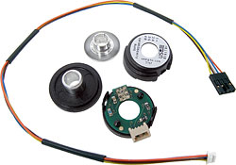
Motor Encoders
Description
“When installed on the TETRIX™ DC Drive Motor, the TETRIX Motor Encoder Pack, along with the HiTechnic DC Motor Controller interface, enables your robot to move a fixed distance, rotate to a specific position, move at a constant speed, reset encoders, and read encoders using the LEGO® MINDSTORMS® Education NXT Software. The pack includes one Motor Shaft Encoder, one Shaft Encoder Cable, one Aluminum Shaft Encoder Set Collar, and assembly instructions. Also compatible with LabVIEW™ and ROBOTC.”
Uses-Controlling Axle Rotation and Distance a Robot Moves
Algorithm Discussion
Robot Discussion
Demonstration
(Item Description From www.legoeducation.com)

Slide 25
Sensor Mux
// Initialize the SMUX.
HTSMUXinit();
// Tell the SMUX to scan its ports for connected sensors.
HTSMUXscanPorts(HTSmux);
wait1Msec(100);

Slide 26
Touch Sensor
Description
“This touch sensor is very basic and is either on or off, depending on the position of the push button. The NXT Touch Sensor features a hole for an axle in the push button, giving users more options for incorporating the sensor into their designs.”
Uses-Detecting Walls, etc.
Algorithm Discussion
Robot Discussion
Demonstration
(Item Description From www.legoeducation.com)

Slide 27
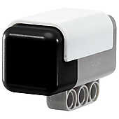
Magnetic Sensor
Description
“The HiTechnic Magnetic Sensor will enable you to build robots that can detect magnetic fields. The sensor detects magnetic fields that are present around the front of the sensor in a vertical orientation.”
Uses-Detecting Magnetic Sources, etc.
Algorithm Discussion
Robot Discussion
Positioning of sensor
Demonstration

Slide 28
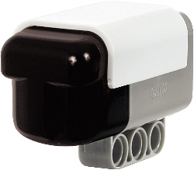
IRSeeker
Description
“Play robot soccer and zero in on your infrared (IR) beacons with the new and enhanced IRSeeker V2 (Version 2). You can use most TV remotes and LEGO® Power Functions remote controls as beacons that the IRSeeker V2 will detect. With a specially designed curved lens and five internal detectors, the IRSeeker V2 has a 240-degree view, making it perfect for playing robot soccer with the Infrared Electronic Ball.”
Uses-Detecting IR Sources, etc.
Algorithm Discussion
Robot Discussion
Positioning of sensor
Demonstration
IR Seeker Vital Information (PDF file)
http://www.usfirst.org/uploadedFiles/Community/FTC/Team_Resources/IRSeekerV2characteristicsR2-rev3.pdf
(Item Description From www.legoeducation.com)

Slide 29
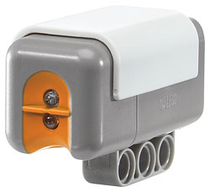
Light Sensor
Description
“The NXT Light Sensor is sensitive and precise. It reads light intensity from the surrounding environment, as well as the reflection from the infrared transmitter. The LED light source can be turned off for an accurate ambient light reading.”
Uses: Detecting and Following Lines
Algorithm Discussion
Robot Discussion
Positioning of sensor
Robot Speed
Dual Sensor Discussion
(Item Description From www.legoeducation.com)

